Slide 1
RL Project
Enduro
Dhruva Kashyap: PES1201801457
Sumukh Aithal K: PES1201801461

Slide 2
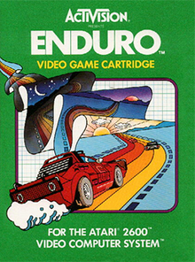
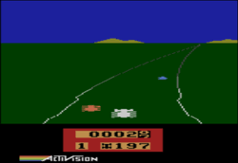
About Enduro

Slide 3
About the Game
Enduro consists of maneuvering a race car in the National Enduro, a long-distance endurance race.
The object of the race is to pass a certain number of cars each day.
Doing so will allow the player to continue racing for the next day. The driver must avoid other racers and pass 200 cars on the first day, and 300 cars with each following day.
From Wikipedia.

Slide 4
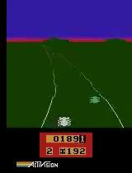
Gameplay
Pro-MLG gameplay.
Played by us.

Slide 5
Observation Space and Action Space
In this environment, the observation is an RGB image of the screen, which is an array of shape (210, 160, 3).
Each action is repeatedly performed for a duration of k frames, where k is uniformly sampled from {2,3,4}
Action Space: Discrete(9);

Slide 6
Actions
9 Actions
PLAYER_A_NOOP:0
PLAYER_A_FIRE:1 (Accelerate!)
PLAYER_A_RIGHT:2
PLAYER_A_LEFT:3
PLAYER_A_DOWN:4
PLAYER_A_DOWNRIGHT:5
PLAYER_A_DOWNLEFT:6
PLAYER_A_RIGHTFIRE:7
PLAYER_A_LEFTFIRE:8

Slide 7
Rewards
In the gym package, a reward of +1 is given for each car passed and -1 for each car that passes the agent.
However, the net reward cannot drop below 0.

Slide 8
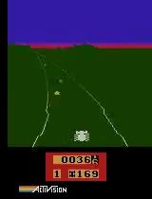
Sample model Gameplay.
Trained for 25 epochs on single 5 minute video.
Simple Architecture with 2 Conv layers.
SGD with momentum with LR=0.01.
Model reaches top 50.

Slide 9
Dataset:
3 gameplays
Name | Duration | Datapoints
t1 | 4:57 | 8194
t2 | 2:43 | 4911
t3 | 7:23 | 13316

Slide 10
Model Architecture
3 different model architectures
Name | Number of Parameters
SimpleNet | 2639801
BigNet | 1007193
ResNet18 | 11284041

Slide 11
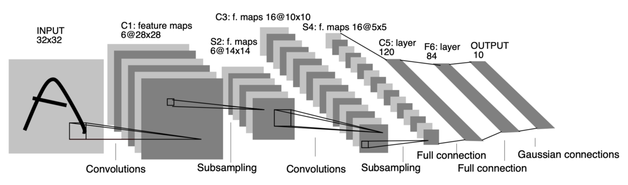
LeNet

Slide 12
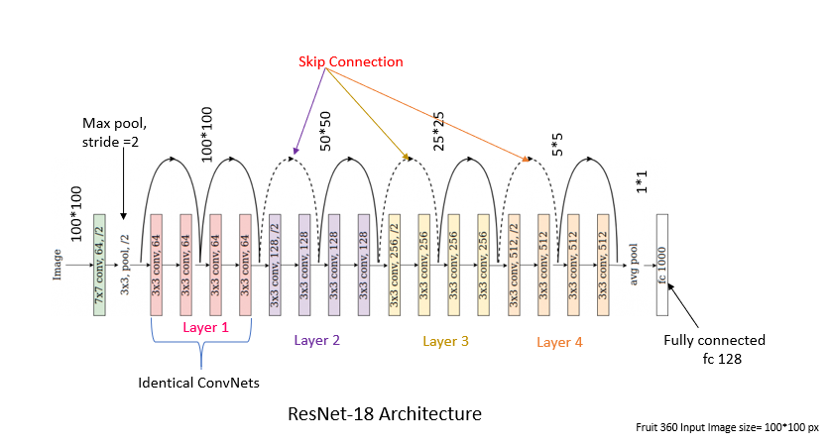
ResNet

Slide 13
Training
Optimizer: Adam and SGD
Batch Size: 64
Epochs: 50
Loss: Cross Entropy Loss
Modeled the problem as 9 class classification problem.
We used optuna to run 100 trials for hyperparameter optimization.
We cropped the image to 160 x 160 and observed improvements.

Slide 14
Results
Model | Optimizer | LR | Rank (in Level 1) | Rank (in Level 2) | Total Number of Cars
SimpleNet | Adam | 1e-5 | 2 | - | 198
BigNet | SGD | 5e-3 | 1 | 100 | 400
ResNet | Adam | 1e-3 | 1 | 150 | 350

Slide 15

Gameplay: SimpleNet model

Slide 16
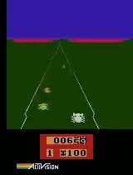
Gameplay: BigNet model

Slide 17
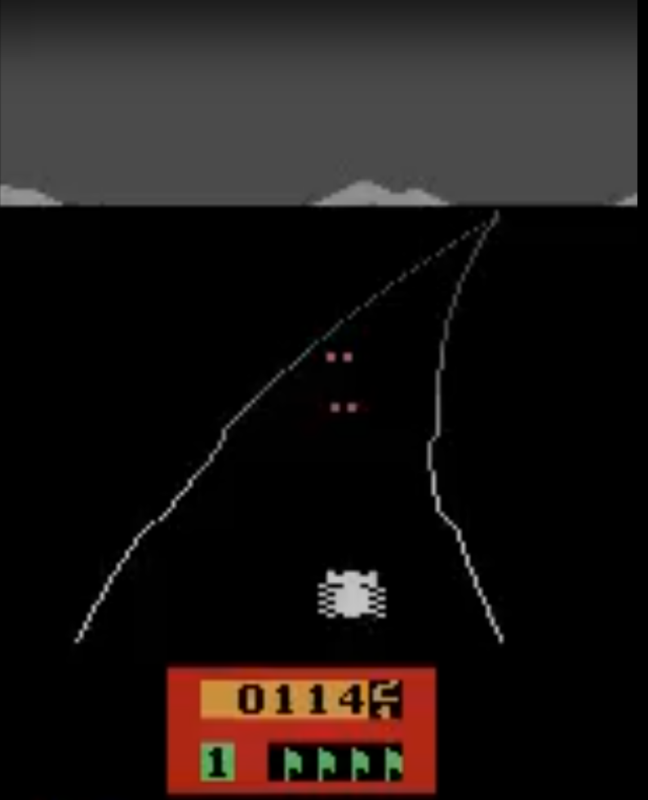
1st Place

Slide 18
Gameplay: ResNet model

Slide 19
Challenges
Limited Training Data We only played the game only till 2 levels. Also we did not play the perfect game. Thus the model had to learn from us
Compute Training ResNet like models was computationally expensive.

Slide 20
Conclusion
Imitation learning is a powerful method to solve challenging reinforcement learning tasks
Simple model with very limited training data was able to play well.

Slide 21
Code and Model weights
https://github.com/sumukhaithal6/Enduro-Imitation-Learning

Slide 22
Thank you

